Slide 1
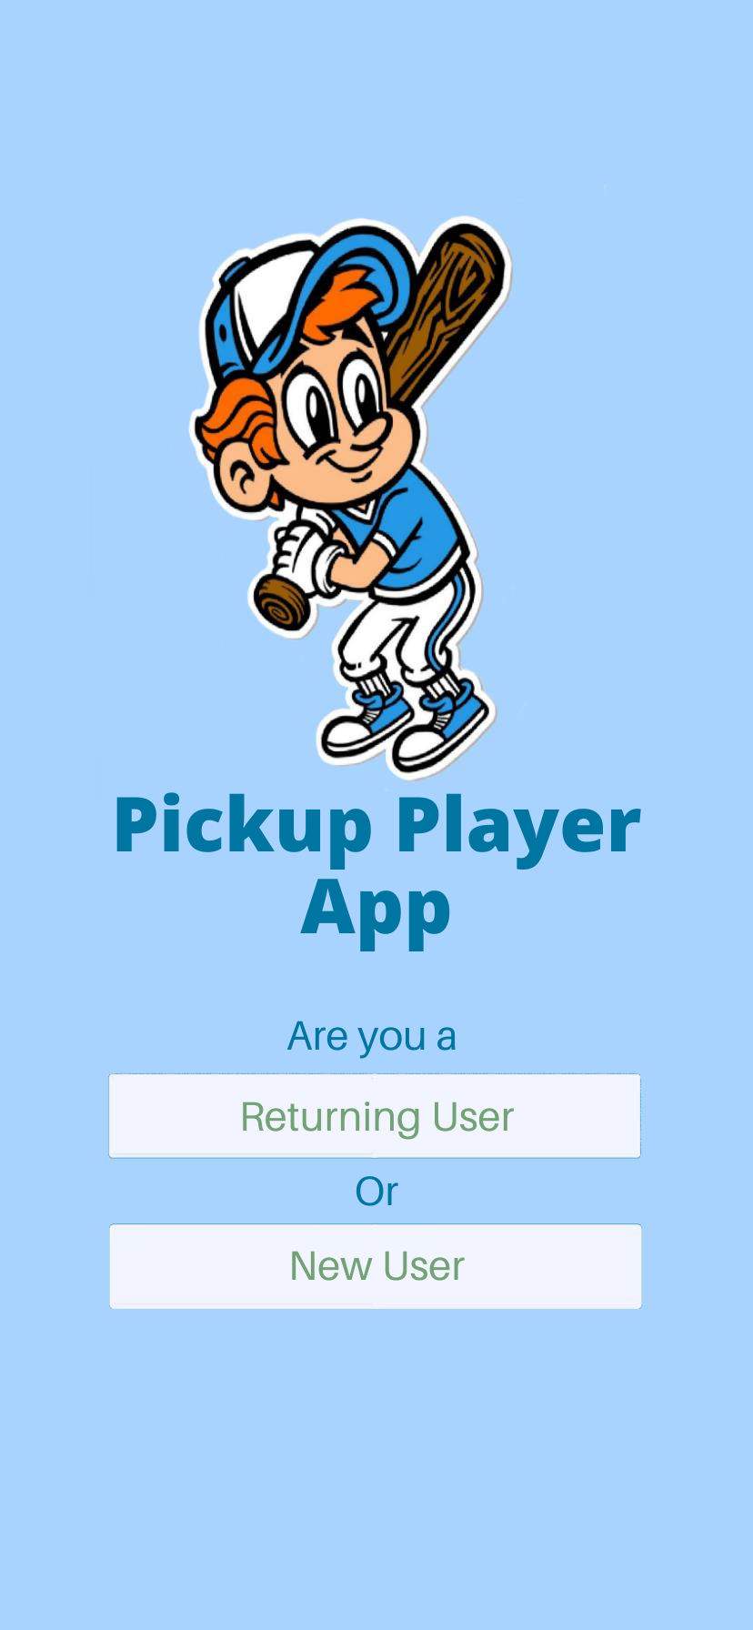
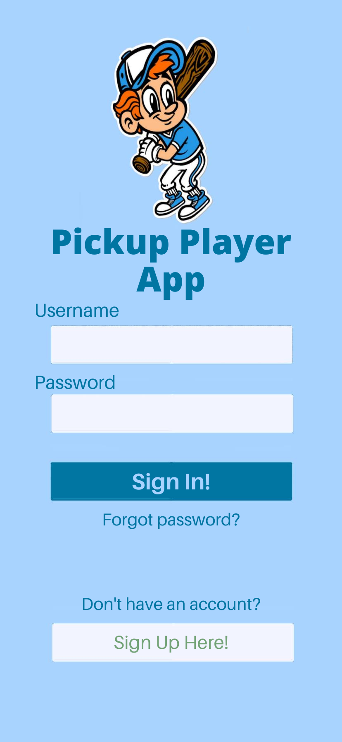
Entry Pages
This is the opening page and where you would sign in after clicking Returning User

Slide 2
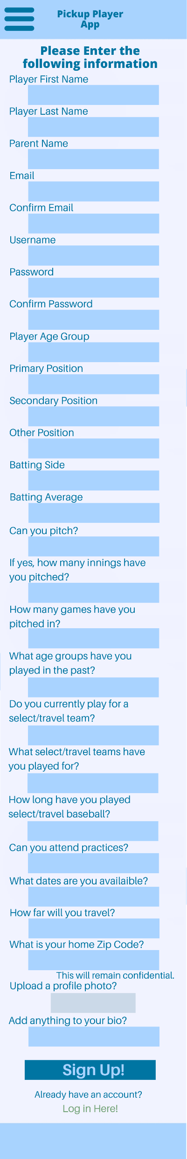
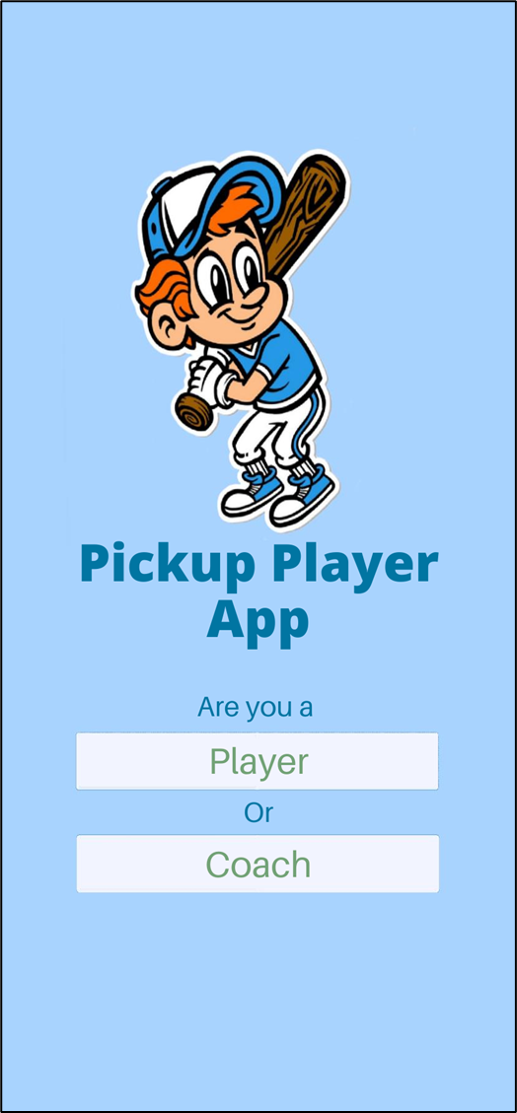
Signup Pages
This is the app control selection and the player account creation featuring all possible needed information though all will not be required.

Slide 3
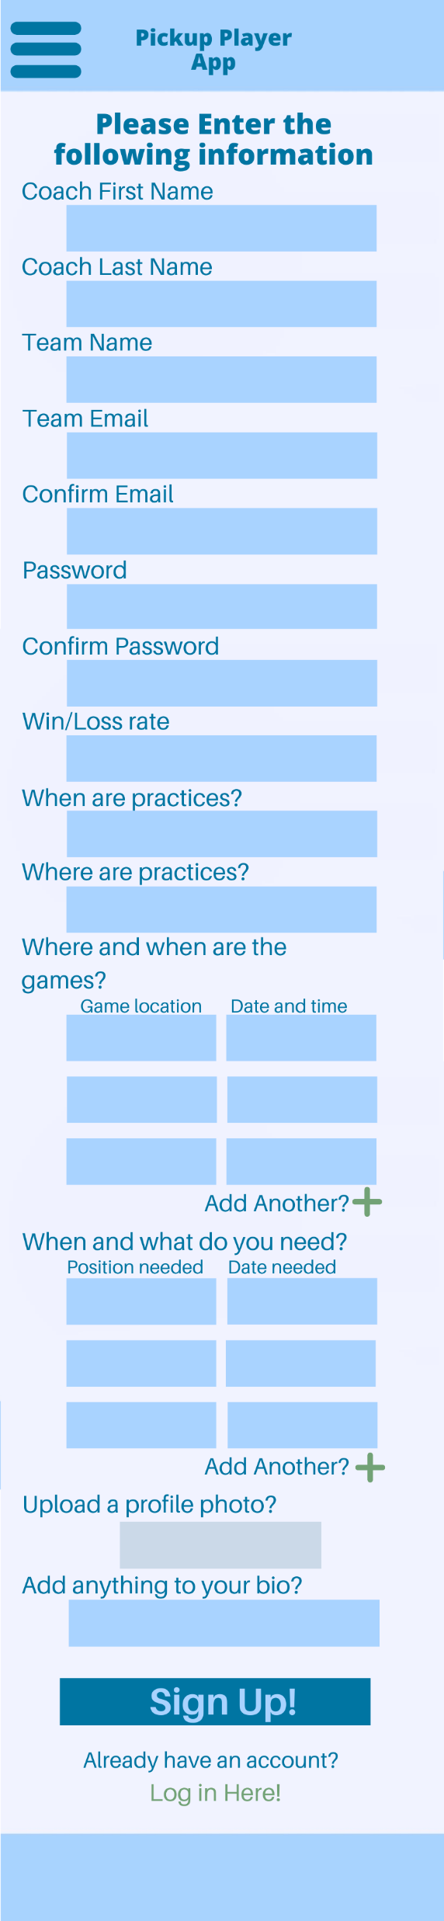
Entry Pages
This is the coach/team creation page and where they will add game and team information. Upon returning this page should have two photo uploads one for team and one for coach.

Slide 4
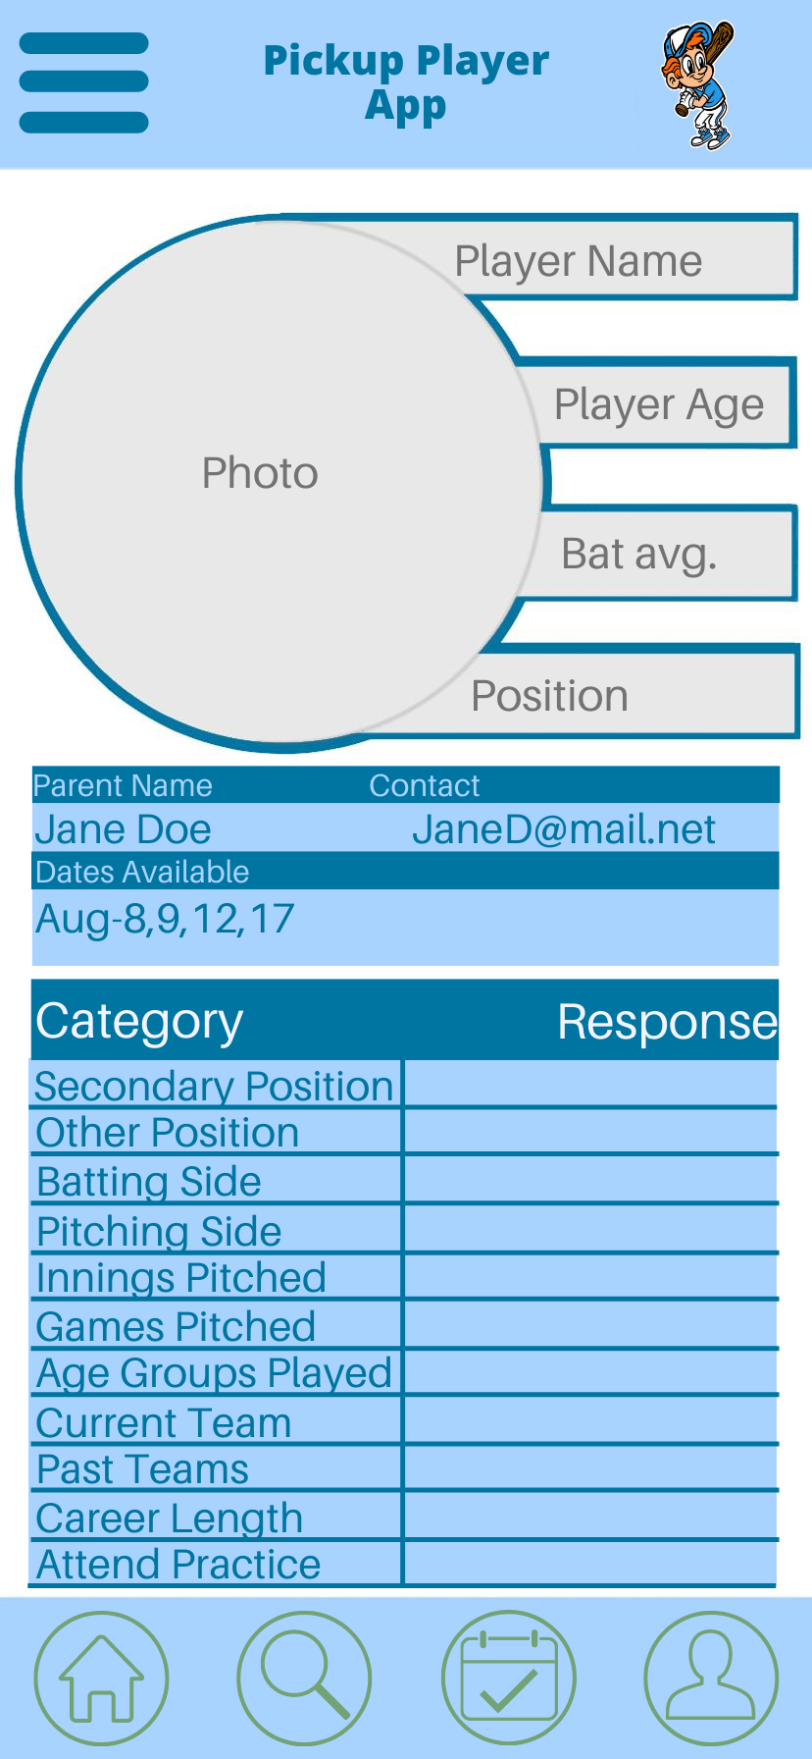
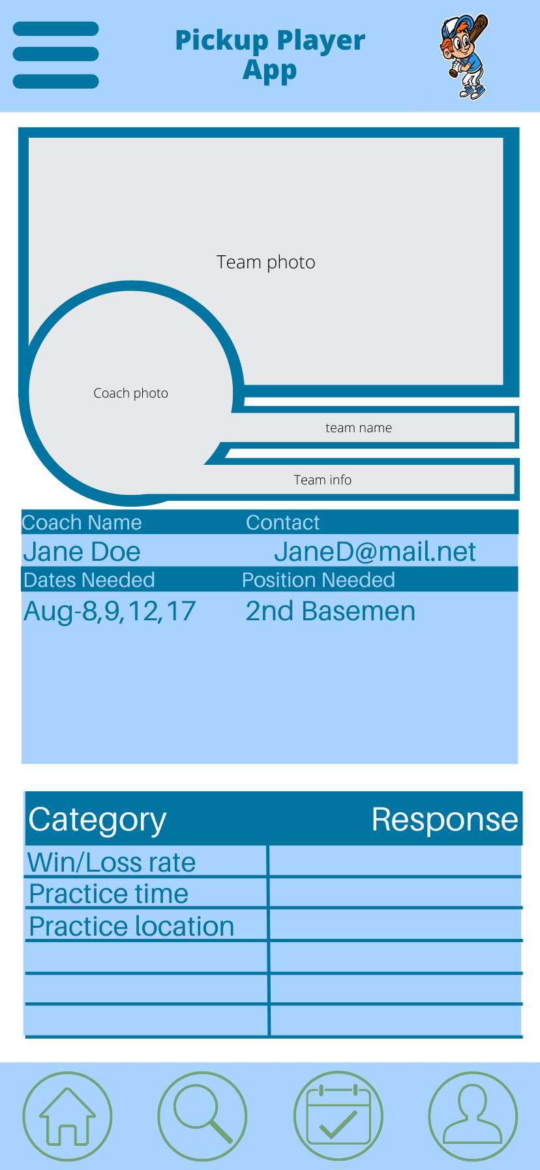
Profile Pages
This is the coach/team profile page and the player profile page. I think scrolling a little further on this page might yield a button along the lines of “message this player/coach/team?”

Slide 5
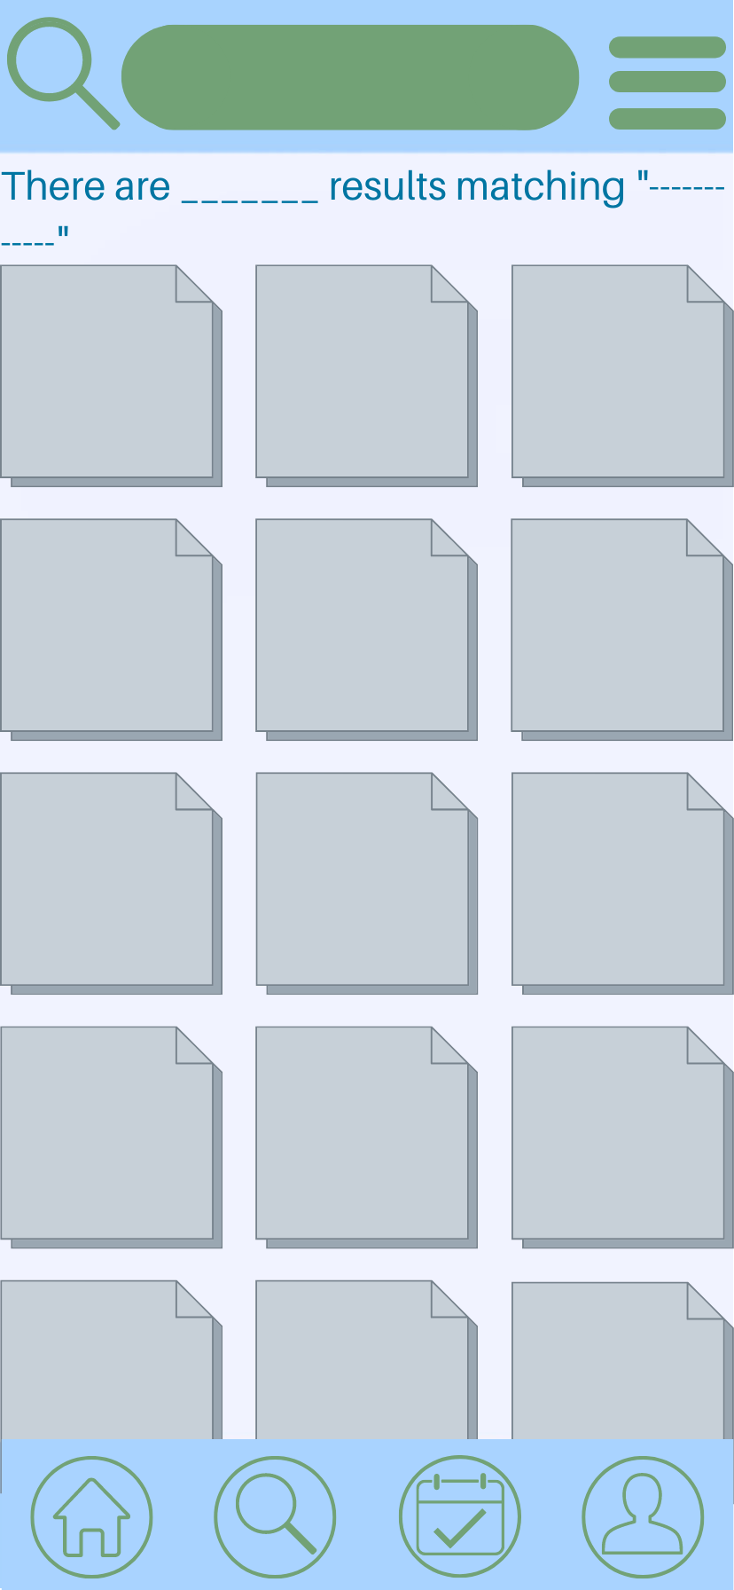
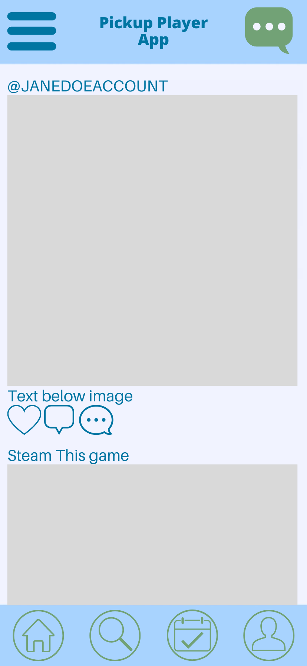
General Pages
This is the search page and home page.

Slide 6
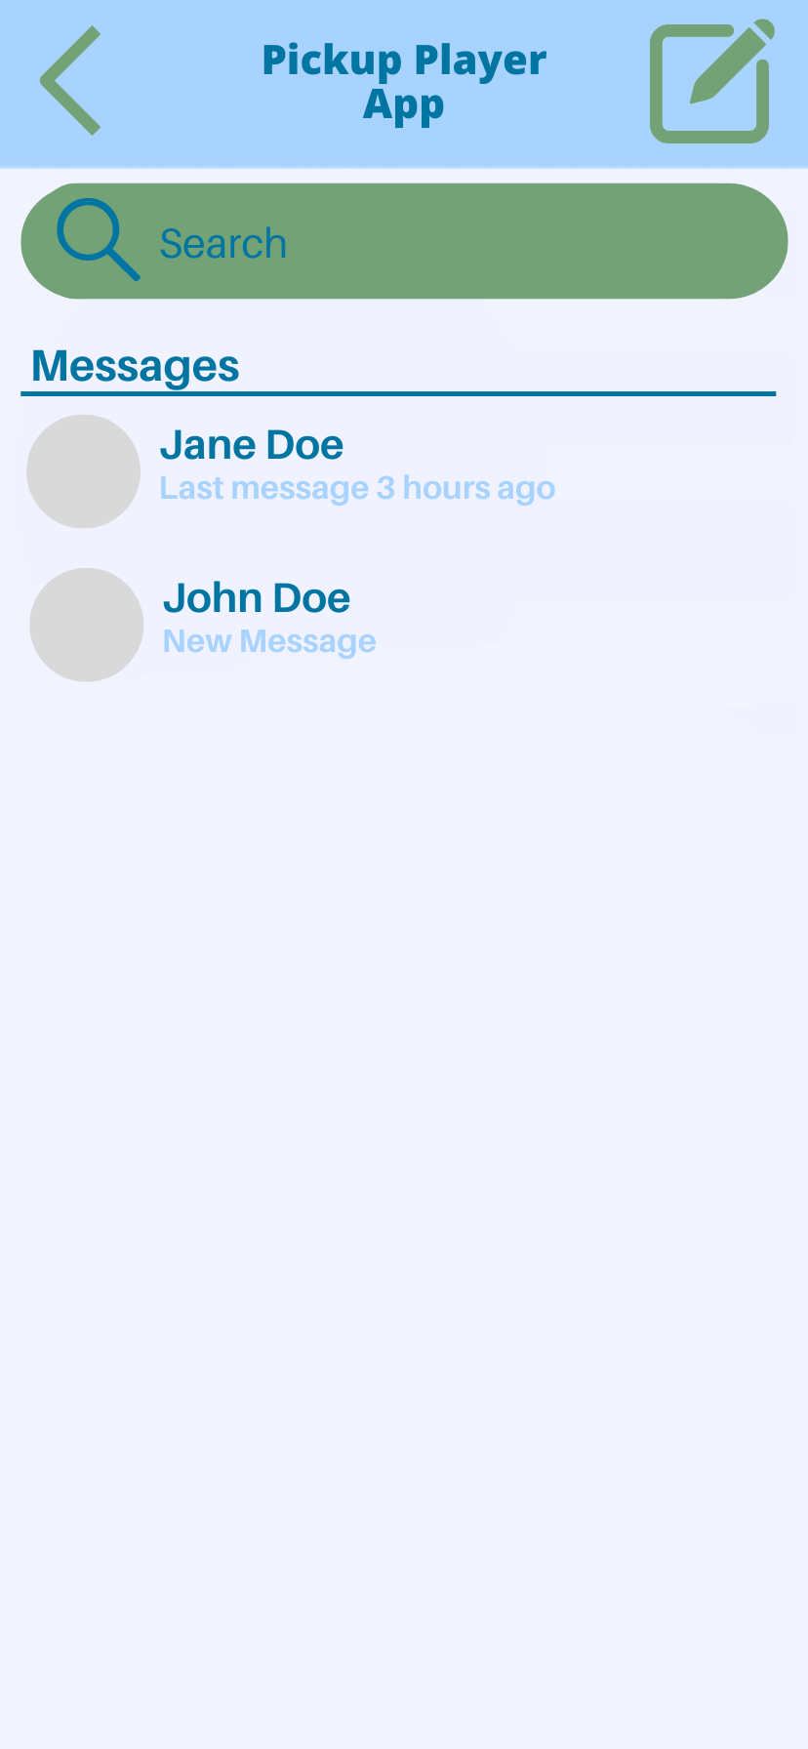
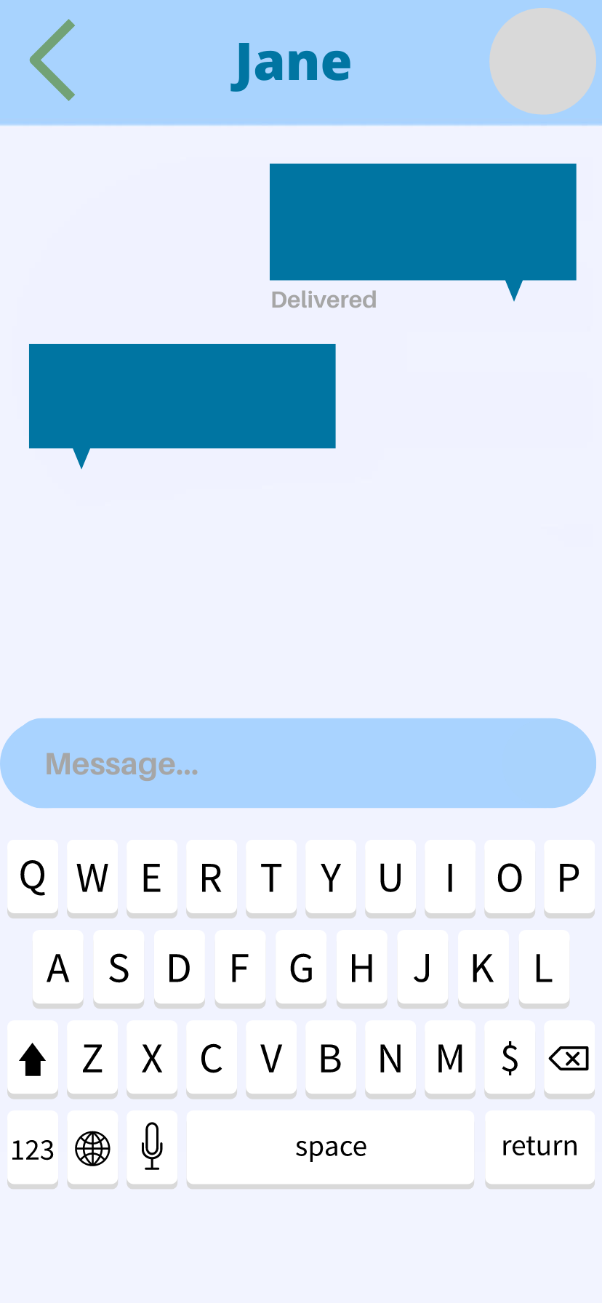
General Pages
This is the message select page and messaging page that for users under 13 would be only autofill chat.

Slide 7
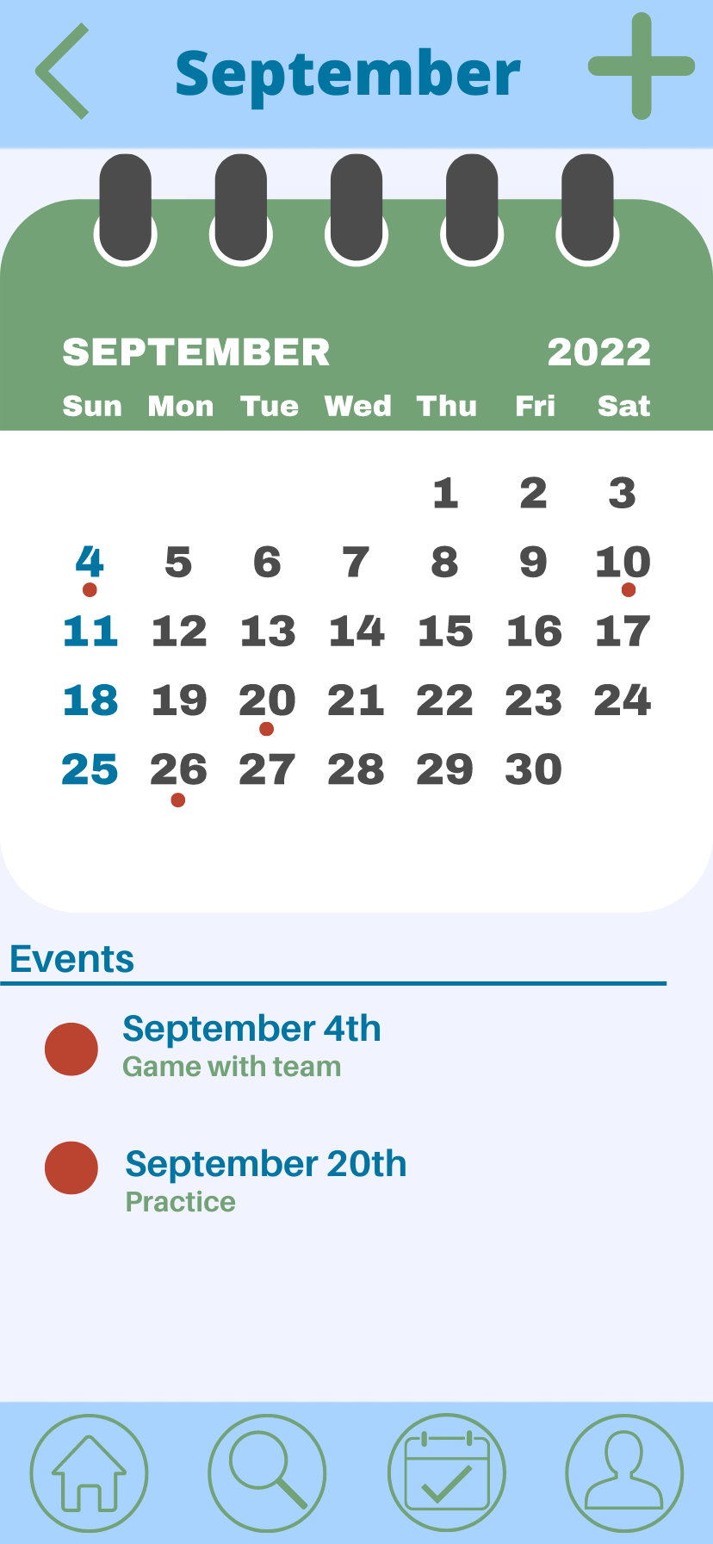
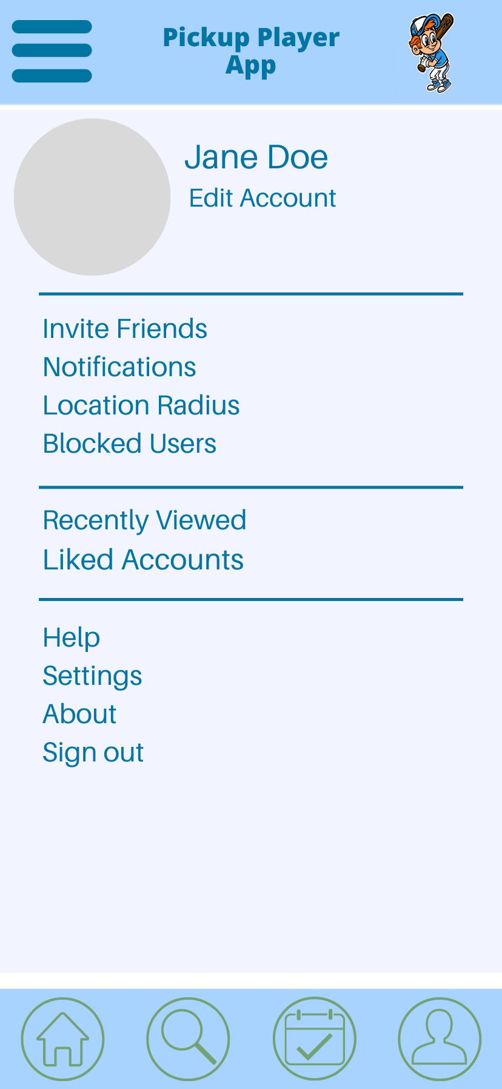
General Pages
This is the calendar page to visually show availability and what you have scheduled in as well as the scheduled event. This is also the main personal profile page.

Slide 8
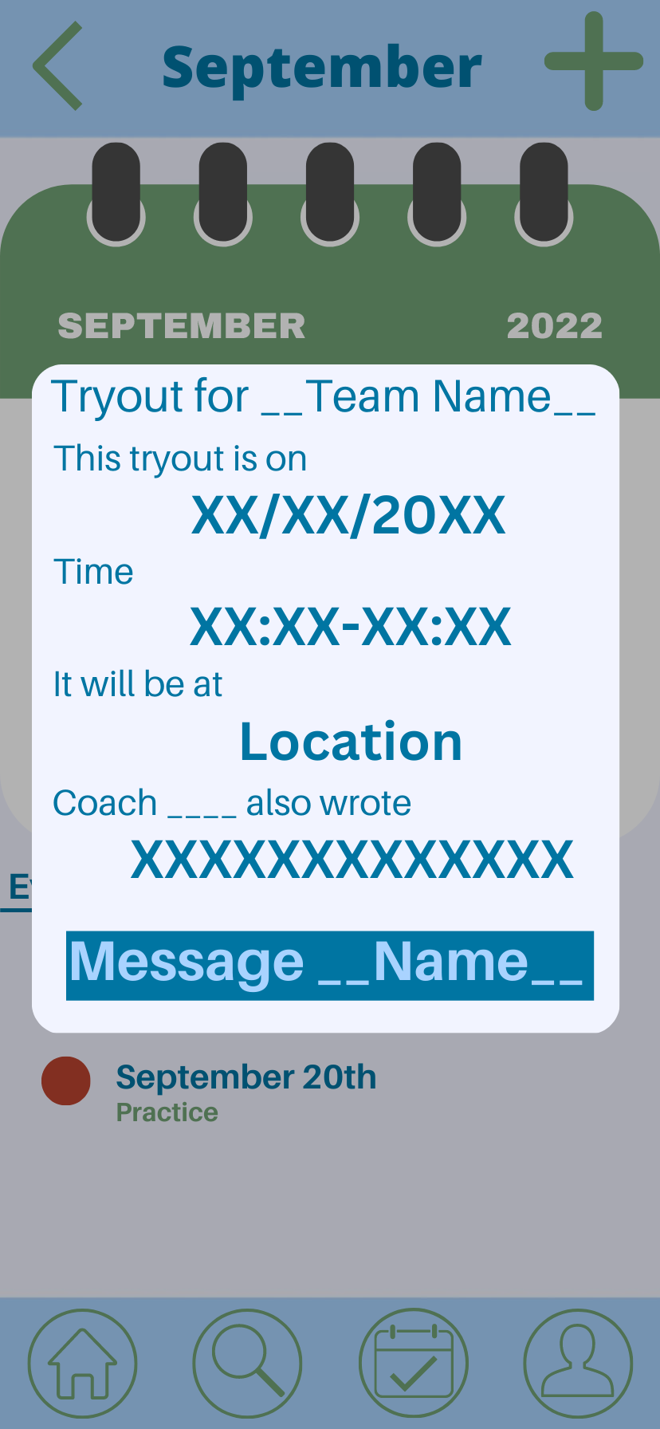
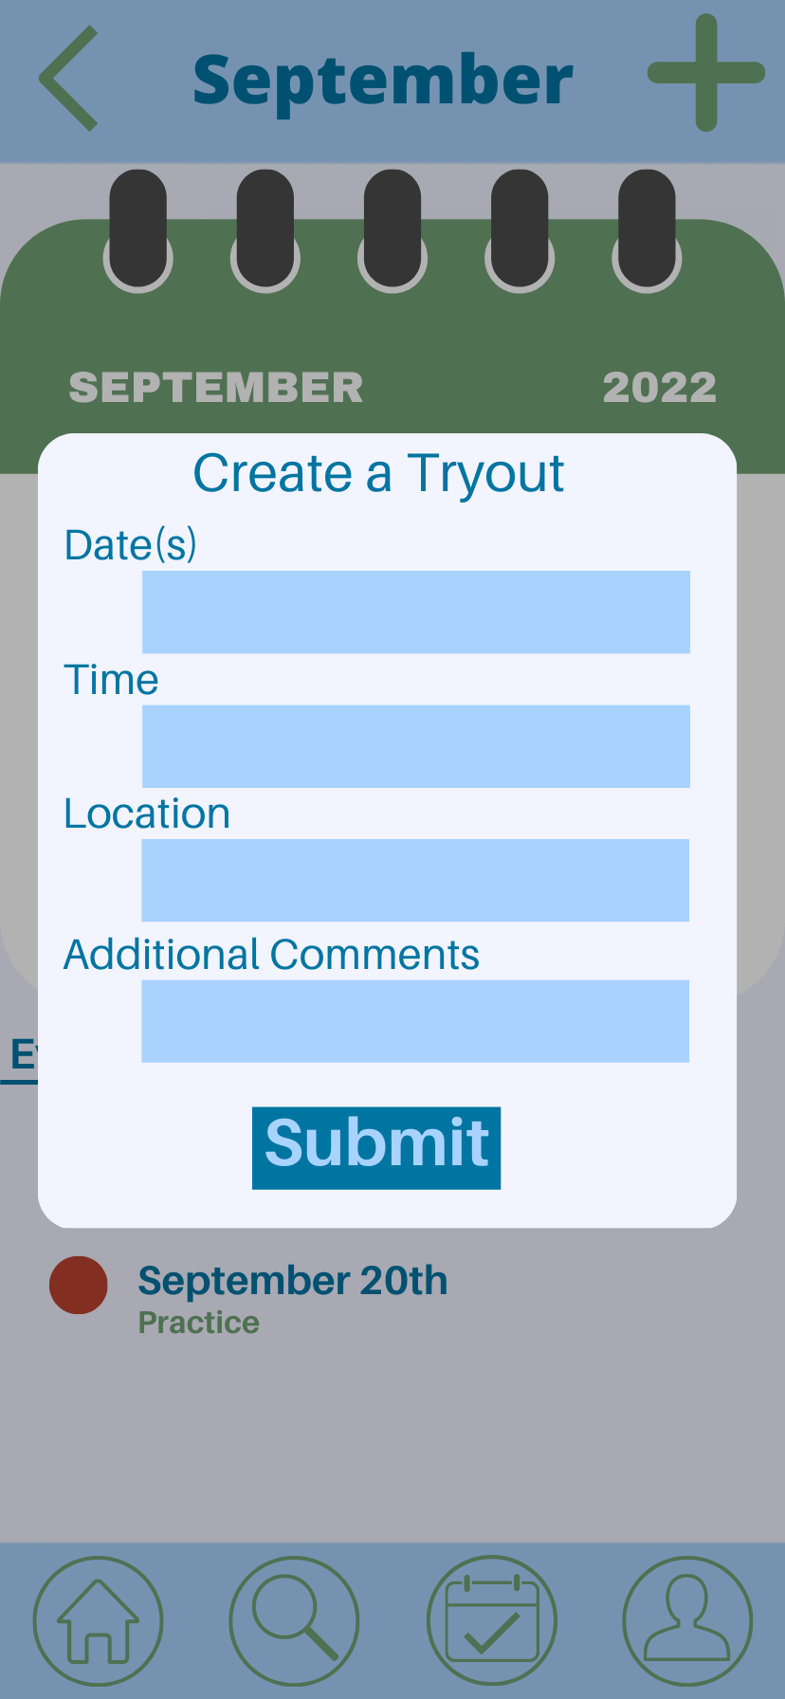
Calendar additions
This is the view for both the player and coach for tryouts.

Slide 9
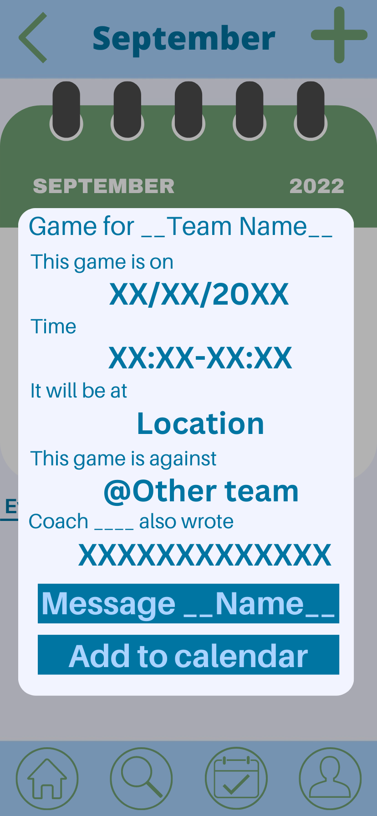
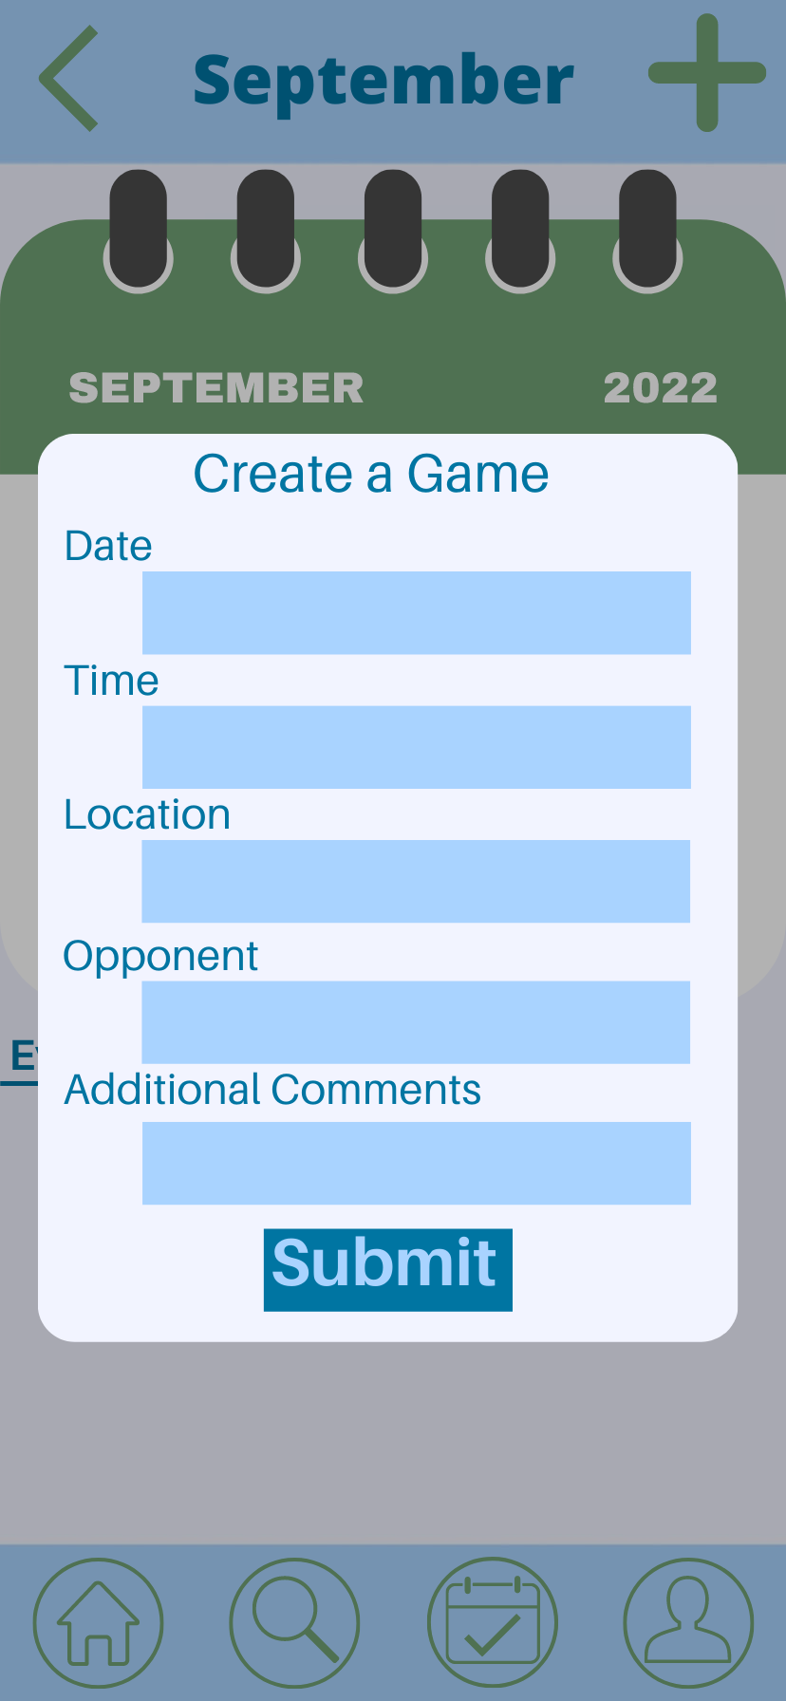
Calendar additions
This is the view for both the player and coach for games.

Slide 10
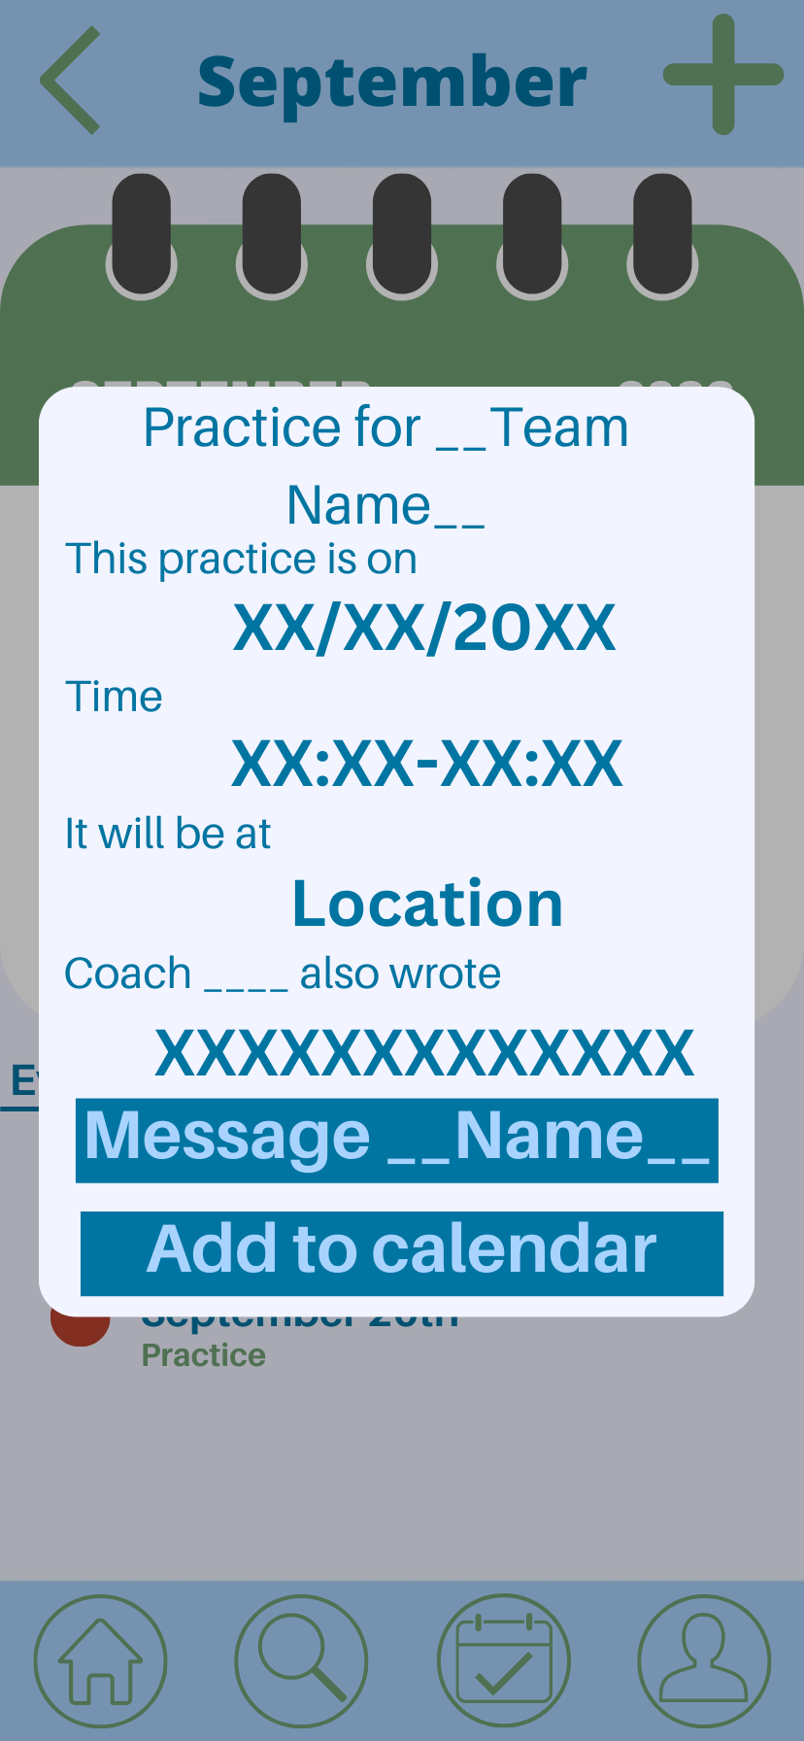
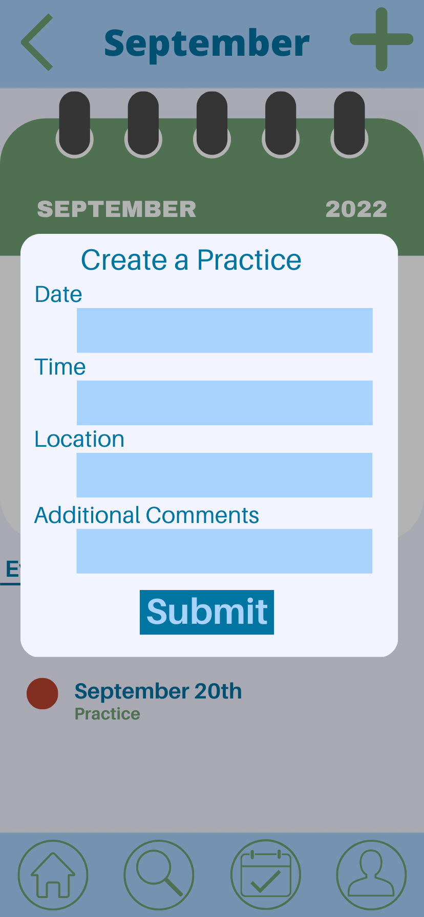
Calendar additions
This is the view for both the player and coach for practices.

